Slide 1
Miami-Dade Real Estate
2021 Pricing Forecast

Slide 2
Data Process
Data Source Zillow
Clean Data
Removed Columns
Remove nann
Transpose

Slide 3
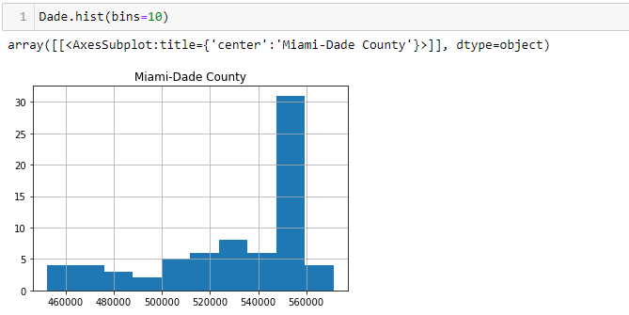
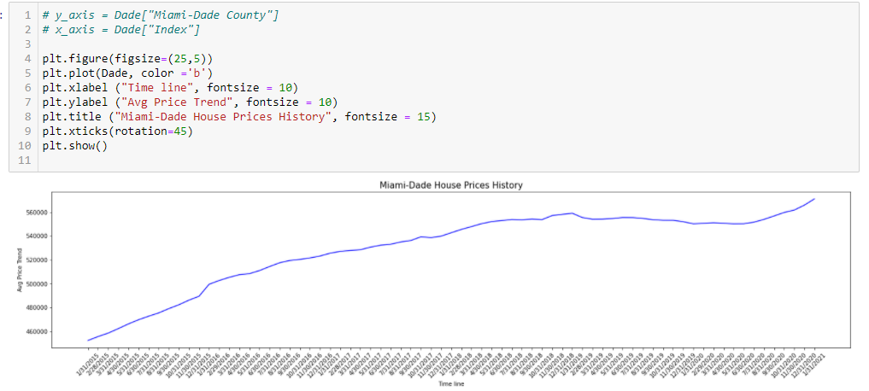
Clean Data
Data Review

Slide 4
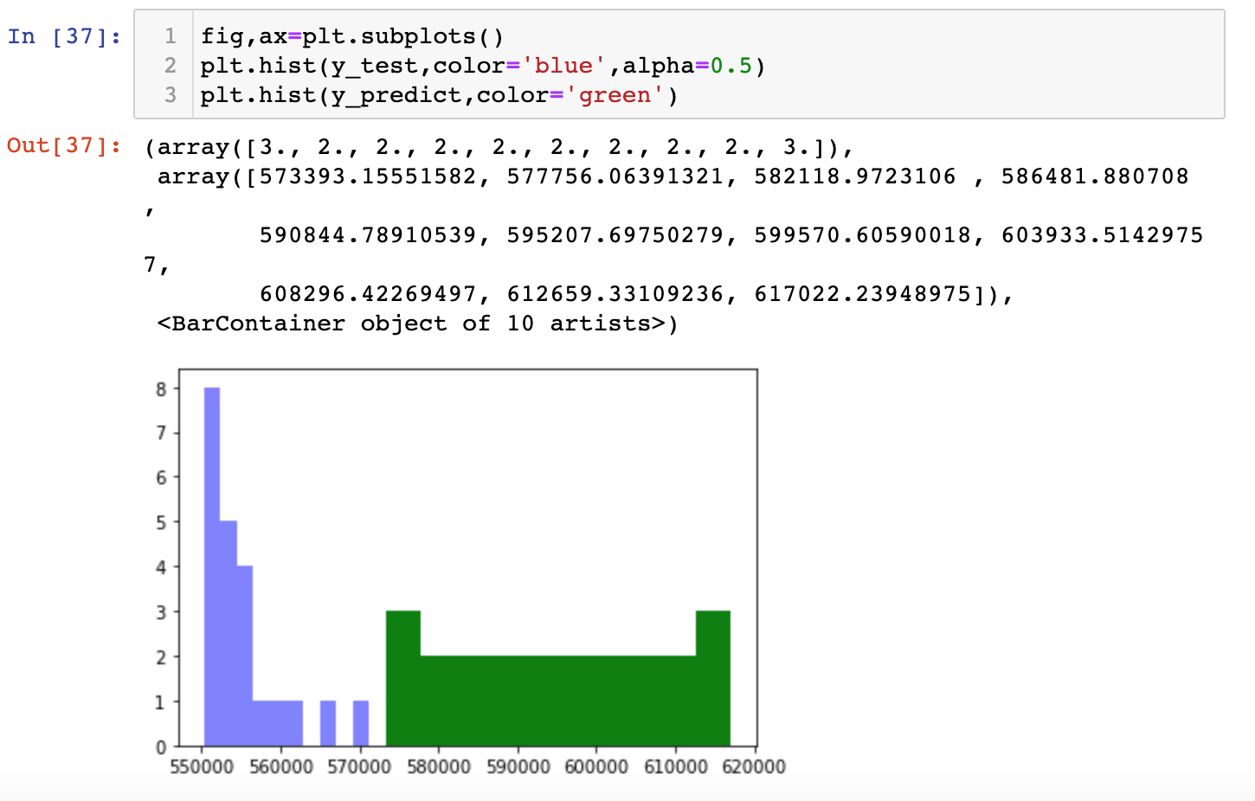
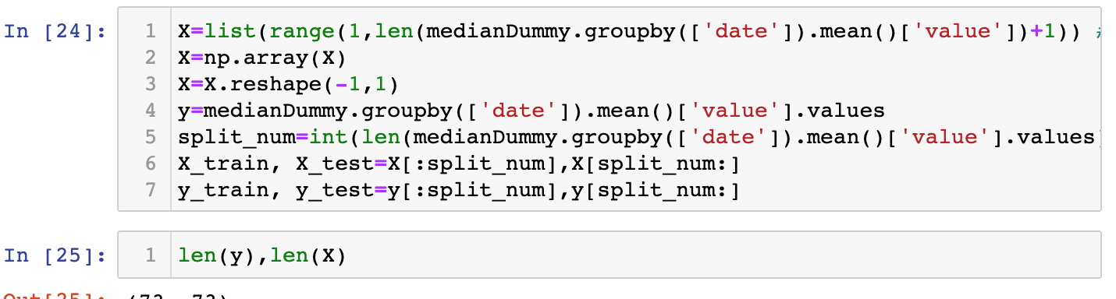
Challenges deep-dive
Challenge 1
Notes:
Streamlit. Could not model the median of the prices with 72 months of data. The forecast for streamlit was off. Blue file data. Green the prediction.

Slide 5
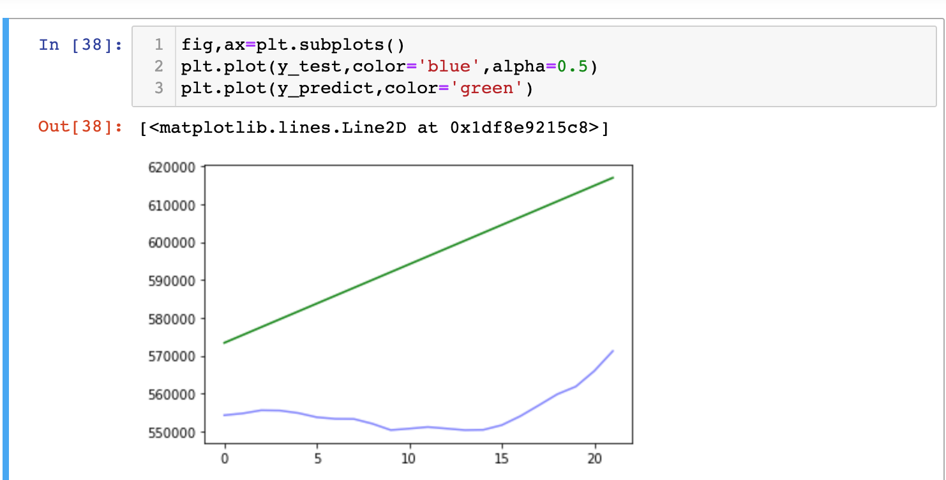
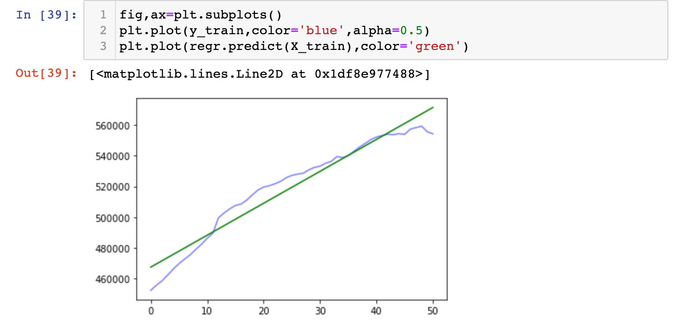
Challenges deep-dive
Challenge 1
Notes:
Additional graphs using streamlit. Tried plotting a regression but the model did not run and prediction was still off.

Slide 6
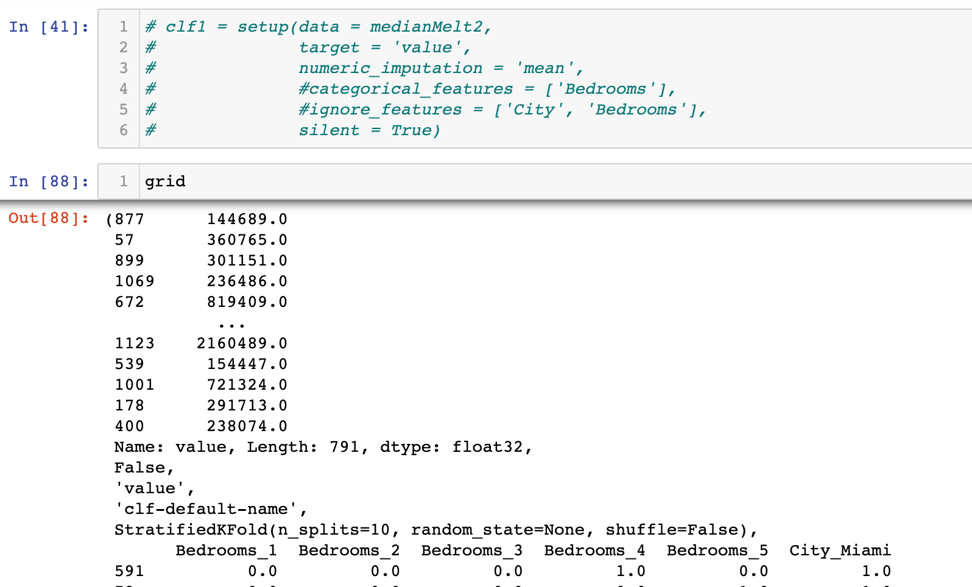
Challenges deep-dive
Challenge 1
Notes:
Trying to get the model to run and got a large mean square number.

Slide 7
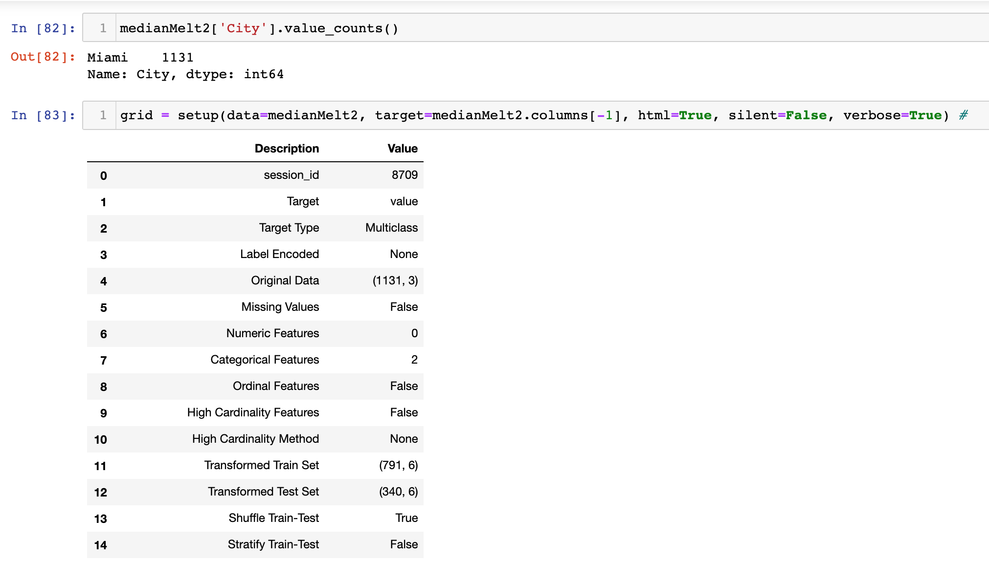
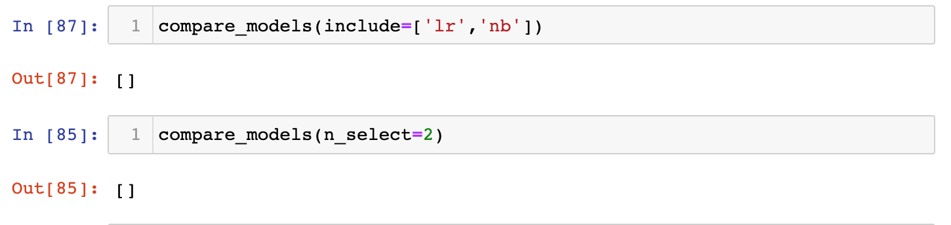
Challenges deep-dive
Challenge 1
Notes:
Pycaret model. Results were supposed to give us several models to compare but we did not get any results.

Slide 8
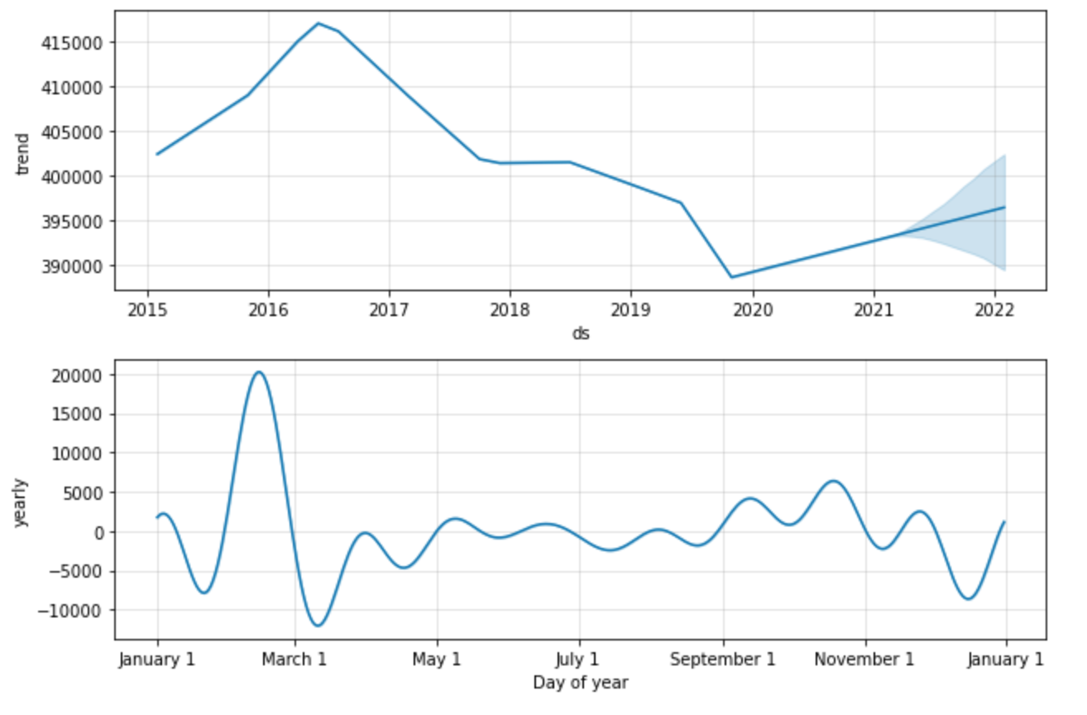
Solution
Model
Notes:
Facebook prophet model provided us with an actual prediction. We had to remove bedrooms and used zip codes to predict price.

Slide 9
ANY QUESTIONS?
max growth

